Slide 1


Green Pace
Security Policy Presentation
Developer: Mina Abadeer
April 10, 2023
Project Two: Security Policy Presentation
https://youtu.be/o7xKAzSv8cc

Slide 2

OVERVIEW: DEFENSE IN DEPTH
The presentation explains Green Pace new security policy for code development
Our security policy’s target is establishing the base for C++ coding standards, authentication, authorization and security principles
The policy support defense in depth principle by adding multiple layers of security to detect and prevent any threats

Slide 3
THREATS MATRIX
Rule | Severity | Likelihood | Remediation Cost | Priority | Level
STD-001-CPP | Low | Unlikely | Low | P3 | L3
STD-002-CPP | Low | Likely | Medium | P6 | L2
STD-003-CPP | High | Likely | Medium | P18 | L1
STD-004-CPP | High | Unlikely | Medium | P6 | L2
STD-005-CPP | High | Likely | Medium | P18 | L1
STD-006-CPP | Low | Probable | Medium | P4 | L3
STD-007-CPP | Low | Probable | Medium | P4 | L3
STD-008-CPP | Medium | Unlikely | Medium | P4 | L3
STD-009-CPP | Medium | Unlikely | Medium | P4 | L3
STD-010-CPP | Low | Unlikely | Medium | P2 | L3
The matrix shows the rule numbers of the security policy code standards.
The matrix show the severity and probability of finding the threat in the code.
It describes the priority of each threat and the cost to fix

Slide 4
10 PRINCIPLES
The Principles | The Coding Standards
Validate Input Data | Don’t change the reference type to const or volatile
Heed Compiler Warnings | Don’t change the reference type to const or volatile, Do not abruptly close the program
Architect and Design for Security Policies | Do not abruptly close the program, Close files when they are no longer needed
Keep It Simple | Do not delete an array through a pointer of incorrect type
Default Deny
Adhere to the Principle of Least Privilege
Sanitize Data Sent to Other Systems | Division by zero no errors, Do not cast to an out-of-range enumeration value
Practice Defense in Depth | Division by zero no errors
Use Effective Quality Assurance Techniques | Creating a std::string from a null pointer is prohibited, detect and handle memory allocation errors, Handle all exceptions
Adopt a Secure Coding Standard | Range Check element access

Slide 5
CODING STANDARDS
Don’t change the reference type to const or volatile
Make sure the division by zero does not cause an error
Never create a std::string from a null pointer
Check the element range before accessing it
Detect and handle memory allocation errors to avoid program termination and denial of services attack.
Close the program in the right way to avoid consuming the system resources
Ensure to handle all exceptions
Don’t cast to an out-of-range enumeration value.
Close the files once you are done with them to free the system resources
Don’t delete an array thought of incorrect type

Slide 6
ENCRYPTION POLICIES
Encryption in rest: protects data saved on a hard drive or a server
Encryption at Flight protects transferred data, for example sending sensitive information using emails.
Encryption in use: protects the data all the time and prevents untheorized access

Slide 7
TRIPLE-A POLICIES
Authentication: authenticating the user before allowing access to the system. authentication tools are passwords, USB key and biometrics
Authorization: allow the users access to specific folders based on their permissions or job descriptions
Accounting: monitoring the user behavior and blocked any suspicious behaviors.

Slide 8
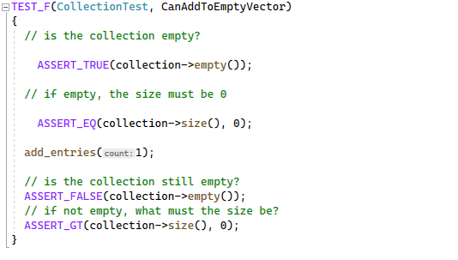
Can add a value to an empty vector
The test is positive test check if the collection is empty or not
If the collection is empty, it adds the value and recheck the code.

Slide 9
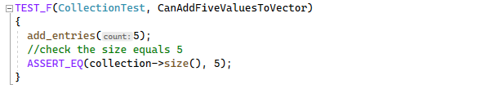
Verify adding five values to collection
The test will add five values.
It will check the collection size to verify if it is increased or not.

Slide 10
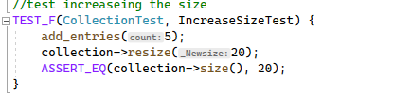
Verify the collection size got increased
The test is positive test.
It will add entries to the collection.
The test will increase the collection size.
It will verify the size got increased.

Slide 11
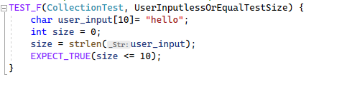
Verify user input size is less than or equal 10
The test is negative test.
It will check user input size and ensure it is less than or equal 10.
The test will expect true if the size is lees than or equal 10

Slide 12

AUTOMATION SUMMARY

Slide 13
TOOLS
DevSecOps: it is the link between development team and the security. DevSecOps combine the security polices with software development process.
Applying coding securing principles and standards achieves the maximum security for the code and the program and eliminates threats in early stages.
Compiling and testing tools help with finding errors and bugs in early stage and fix them before they get mor complicated

Slide 14
RISKS AND BENEFITS
Leaving security till the end will cause complicated issues and it will badly affect the program security and operations.
Analyzing the risk and the mitigations cost in early stages will maximize the code security and prevent future attacks.
applying securing code principles and follow code standards will eliminate many of the code errors and bugs.
Using defense in depth will add multiple layers of security to prevent future attacks.

Slide 15
RECOMMENDATIONS
Using automated testing tools discovers errors and bugs in early stage and prevent future security issues.
Adding multi factor authentication to the code prevents untheorized access
Applying least privileges principle protects sensitive information.
Satanizing the code prevents SQL injection attack

Slide 16
CONCLUSIONS
Adopting secure coding principles is the first step in securing the code
Following the code standards is essential for code security
Repeat testing is our main weapon in fighting threats
Encryption and Triple-A are required for any good code or program
Trust no-one when it comes to security
Deny permissions by default

Slide 17
REFERENCES
DevSecOps—Development, security and operations. (2021, September 17). Dynatrace. https://www.dynatrace.com/monitoring/solutions/devsecops-ciso/?utm_source=google&utm_medium=cpc&utm_term=devsecops&utm_campaign=us-appsec-application-security&utm_content=none&gclsrc=aw.ds&gclid=EAIaIQobChMI67nu7eKg_gIVvXZvBB2BFga4EAAYASAAEgIH6fD_BwE
The motivations of a hacker. (n.d.). https://www.swcomms.co.uk/blog/article/the-motivations-of-a-hacker
SEI CERT C++ coding standard - SEI CERT C++ coding standard - Confluence. (n.d.). https://wiki.sei.cmu.edu/confluence/pages/viewpage.action?pageId=88046682

